Slide 1
Top Car Sales: Nationally vs. Georgia
Alan Huerta Amanda Davis
Ashley Plunkett
Hima Devulapalli

Slide 2
Motivation
Goal:
To identify real time consumer trends in car sales nationally versus locally (Georgia) by manufacturer make and model.
How:
Access Car Sales Data
Create visualizations to view the top 5 makes and model on a national and local level.
Why:
Consumer Preference Change
Effectiveness of Manufacturer Marketing Campaign
Holiday/Weekend Sales Fluctuations

Slide 3
Data
Marketcheck API
Provides access to New, Used and Certified cars inventory for all car dealers in USA and Canada.
The data at API backend is refreshed every 24 hours
Captures 7 days of data rolling
Data Source
Over 53,000 Car dealer websites in USA
6.2M searchable listings for Used & Certified cars and about 6.6M New car listings from all over USA.
Autobot
The data is mined from dealer websites on a daily basis
“Polite” web scraper

Slide 4
Data Cleanup & Exploration
API
https://marketcheck-prod.apigee.net/v1/popular/cars?api_key=3XhPmWArI3SYYbfFZpGuUFLEtVgEZvEn&car_type=new
Building the Data Frame
Analyzing the API to pull the information needed
Setting up the API for National and State level

Slide 5
Data Analysis
Nationally
Make (look at the make level in terms of car sales)
Model (look at the model level in terms of car sales)
Count = Sales
Top Five
Georgia
Make
Model
Count = Sales
Top Five

Slide 6
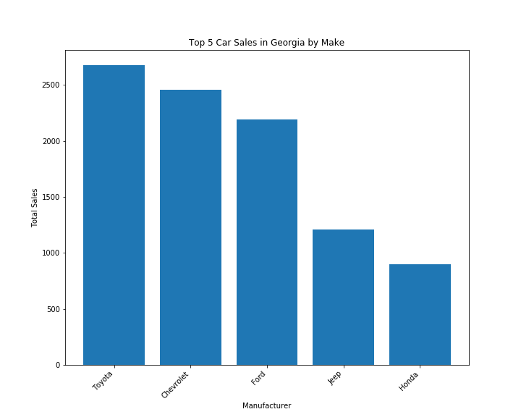
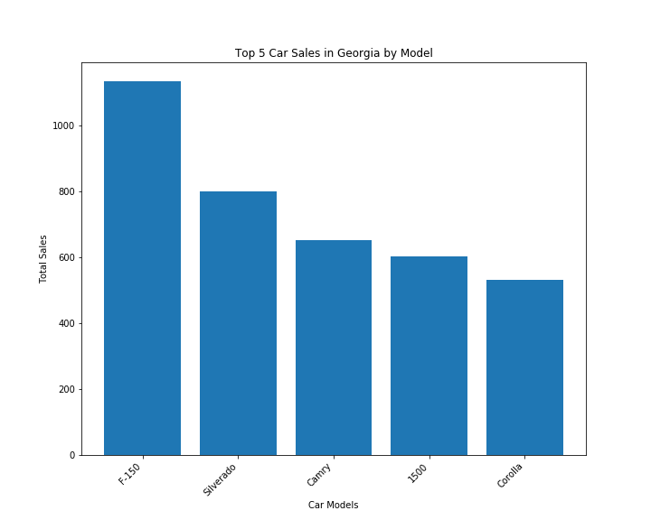
Georgia Car Sales for the period of October 3-10, 2019
Notes:
Interesting to see how the top manufacturer doesn’t necessarily mean top Model : Here we answer the first goal and main question what are the top makes (toyaota, Cheverlet, Ford, Jeep, Honda) and models (f-150, Silverado, Camery, Jeep, Carolla) in Georgia. If we wanted to go into deeper analysis we can go and see which dealerships in Georgia had sales and promotions and whether that had an effect on sales.

Slide 7
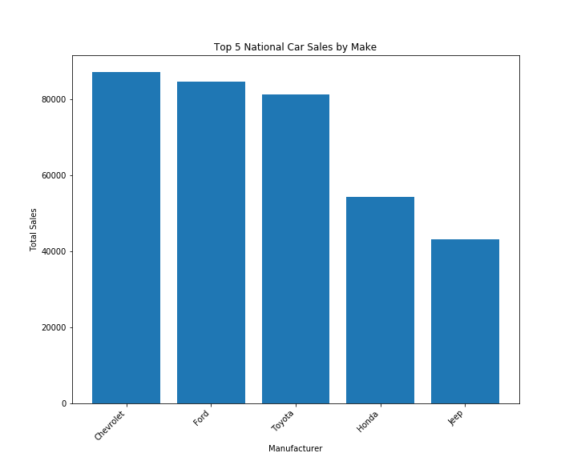
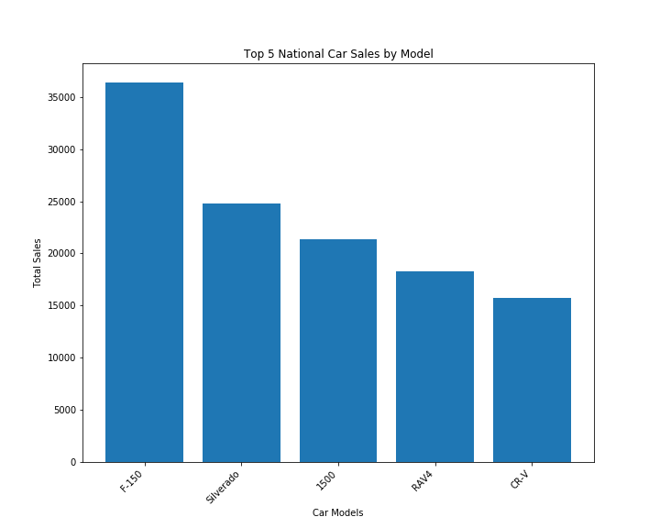
USA Car Sales For the period of October 4 – 11, 2019
Notes:
Here we would answer our second question, regarding sales in the USA: >345K
Model 112K

Slide 8


GA Vs. USA Make

Slide 9


Ga vs. usa model

Slide 10
Comparison USA VS. GA Sales
National Overview Analysis
Top 5 Makes:
Chevrolet, Ford, Toyota, Honda, Jeep
>80,000 Chevy cars sold
> 350,000 cars sold
Top 5 Models:
F-150, Silverado, 1500, Rav4, CR-V
>35,000 Ford F-150 sold
> 115,000 models sold in top 5
Georgia Overview Analysis
Top 5 Makes:
Toyota, Chevrolet, Ford, Jeep, Honda
>9,000 cars sold
Top 5 Models:
F-150, Silverado, Camry, Jeep, Corolla
>3,500 cars sold
Notes:
Background information in 2018 according to Kelly Bluebooks 17.2 million cars, which means about 47K are sold a day. Are data in terms of Make shows that roughly 1000 cars where sold a day for the top 5 makes. If each state does about the same than we are on par.

Slide 11
How can this Be USed
Seeing the fluctuations in cars sales within the past week can be a good indicator of when consumers choose to buy
Holiday
Sales
Gauge success of promotions, release of new models, role to new model year
When a manufacturer releases a new model what impact does it have on others.
This is real time data so you can see changes immediately. Tracking of this during a promotional period a trend may develop.

